Slide 1
CHAPTER 4: Iteration Control structures
Part 1 - 'FOR' LOOPS IN PYTHON
CLO2: Develop programs using selection and iteration control structures to implement control flow.

Slide 2
Document Revision CONTROL (DRC)
X.Y
X: Major change
Y: minor change
Version | Author | Effective Date | Change Description | DRC No
1.0 | Dr. Liew Keat | May 2024 | Provided Resources | 1.0
2.0 | Jumana Tarazi | June 2024 | Developed the first version | 1.0
2.1 | Jumana Tarazi | August 2024 | Reviewed the slides | 1.0

Slide 3
Lecture Notes
Contents of lectures are based on the textbook, recommended text, and supplementary material.
  Please read Chapter 3 of the e-textbook: How to Think Like a Computer Scientist from page 41 to page 60.

Slide 4
LECTURE OUTLINE
Overview of Iteration Control Structures in Python
Types of Iterations in Python
Using for Loops with range()
For Loops in Problem Solving

Slide 5
Overview of iteration Control structures (Loops)
Iteration refers to the ability to execute a block of code multiple times.
An iteration, also know as a loop, allows you to write the sequence of operations once and run it multiple times.
Notes:
Without loops, you would need to write the same code over and over for each time you wanted to perform an action.

Slide 6
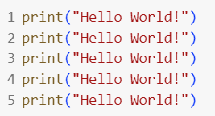
Why do we need Loops?
Suppose you want to print the message "Hello, World!" to the screen 5 times
Without a loop, you would need to write the print statement 5 times manually.
Notice the code is repetitive!

Slide 7
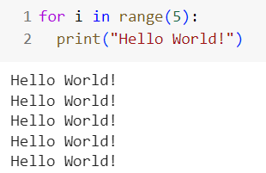
Why do we need Loops?
With a loop, you can achieve the same result with much less code.
You would write a loop that iterates 5 times, printing "Hello, World!" to the screen during each iteration.
Notice that in the given example, the print statement is written once, and it is repeated 5 times!

Slide 8
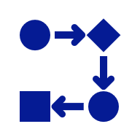
Types of Iterations (Loops) in Python
Python primarily uses two types of loops: 'for' loops and 'while’ loops.
Each type of loop has its specific uses and syntax.
'for' loops are used for iterating over a sequence (like a list).
'while' loops are used to repeat a block of code as long as a condition is True.
  We will explore ‘while' loops in the next lesson.

Slide 9

Overview and Syntax of 'for' Loops
The for loop in Python allows you to iterate over a sequence of elements.
The syntax of a for loop is as follows:
The Loop Control Variable
The variable i is called the loop control variable.
It takes each value in the sequence one by one and keeps track of the repetition.
Generating Sequences with range()
To generate the sequence of numbers, we can use the range() function (next slide).
The block of code that repeats has to be indented,
Notes:
The number of repetitions is determined by the sequence.

Slide 10

Using for loops with range() function
The range() function generates a sequence of numbers.
Useful when you want to repeat an action a specific number of times.
Syntax of for loop with range():
The range() function generates numbers from start to stop - 1, incrementing by step.
start: Starting value of the range. Start is optional and default value if omitted is 0.
stop: The end value of the range.
step: The amount by which the variable is incremented. Step is optional and default value if omitted is 1.

Slide 11
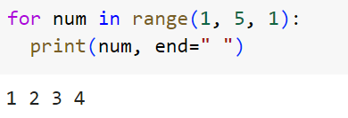
Using For Loop with Range()
Scenario: Use a for loop to generate and print the numbers from 0 to 5.
num takes on the values in the sequence generated by range(), one value at a time.
The loop prints numbers from 1 to 4 (stop -1).

Slide 12
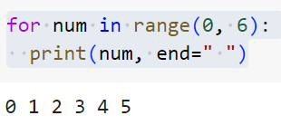
Using For Loop with Range()
Scenario: Use a for loop to generate and print the numbers from 0 to 5.
Since the step is omitted, default value 1 is used.
The loop prints numbers starting from 0 to 5 (stop -1).

Slide 13
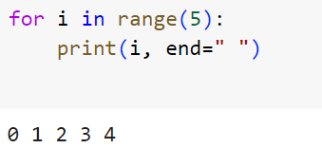
Using For Loop with Range()
Scenario: Use a for loop to generate and print the numbers from 0 to 4.
stop= 5 , start = 0, step =1
When the range() function has one argument, it is interpreted as the stop argument with the start = 0.
The loop repeats 5 times and prints 0 to 4.

Slide 14

Range() function: Progress Check!
Start and Step are optional.
Stop is mandatory.
Code | Sequence Generated
range (5) | ?
range (2,10,3) | ?
range(5,0,-1) | ?
range(3,9) | ?
? | 1,3,5,7

Slide 15
Range() function: Progress Check!
Code | Sequence Generated
range (5)
range (2,10,3)
range(5,0,-1)
range(3,9)
 | 1 3 5 7
0 1 2 3 4
2 5 8
5 4 3 2 1
3 4 5 6 7 8
range (1,8,2)

Slide 16
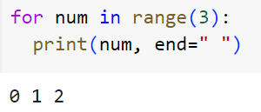
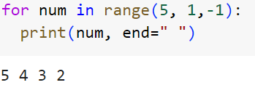
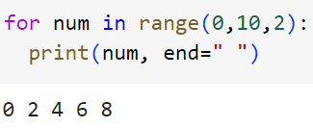
For Loops with Range(): Progress check!
Sample code | Number of repetitions
3
4
5

Slide 17
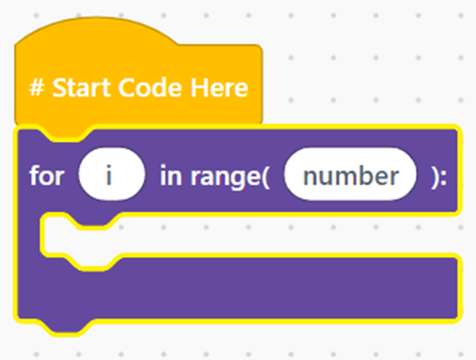
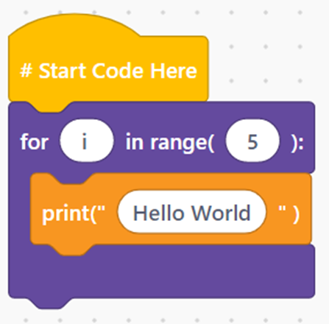

for Loop (EduBlocks)
General Syntax
Example
loop statements are found under the category

Slide 18
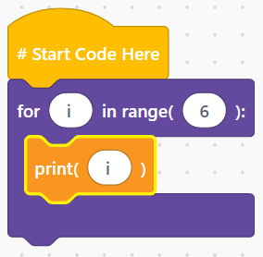

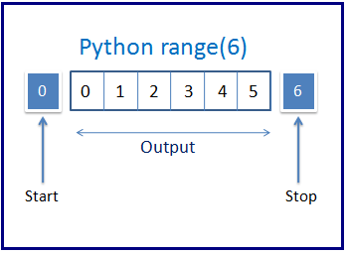
FOR LOOP – EXAMPLE (EDUBLocks)
Print the sequence 0 , 1 , 2 , 3 , 4 , 5
The action being repeated in this loop is just to print the value of i, the loop variable
Notes:
To print without a newline, use print(i, end = ' ')

Slide 19
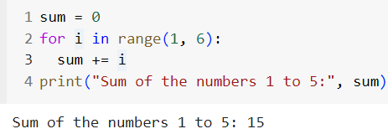
Using for loops in problem-solving
Write a Python program that uses a for loop to calculate and print the sum of the numbers 1 to 5.
The loop variable i is being summed in each repetition to solve the problem
Notes:
the loop variable i is being summed at each repetition to solve the problem

Slide 20
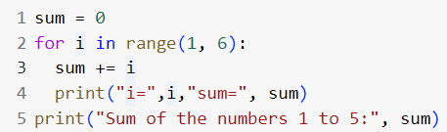
Progress check!
What are the values of i and sum as the program executes?
i | sum
? | ?
Notes:
Lecturers can/shld also use the IDE debugger to demonstrate the execution of the program and the changing values of variables.

Slide 21
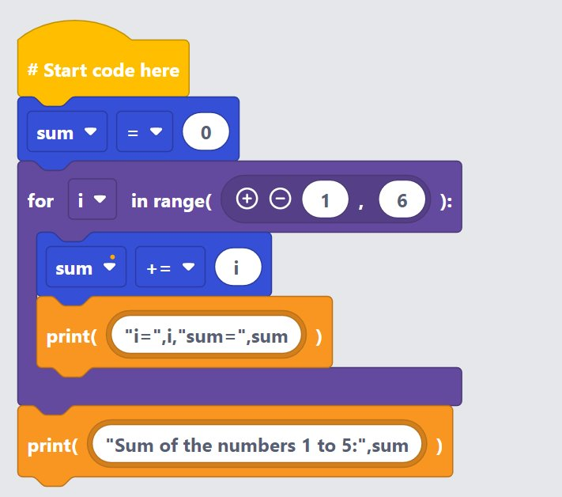
Progress Check: SOlution in Edublock

Slide 22
Progress Check!
What are the values of i and sum as the program executes?
i | sum
i=1 | sum=1
i=2 | sum=3
i=3 | sum=6
i=4 | sum=10
i=5 | sum=15
Notes:
Lecturers can/shld also use the IDE debugger to demonstrate the execution of the program and the changing values of variables.

Slide 23
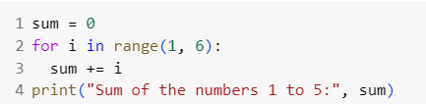
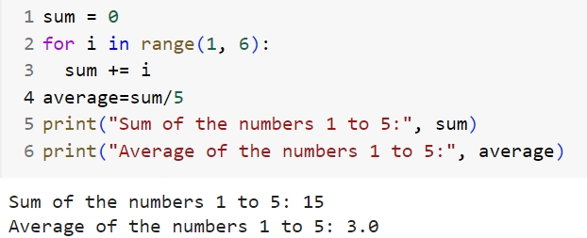
Using for loops in problem-solving – Progress check!
Update the following code to calculate and display also the average of the numbers from 1 to 5!
Solution:

Slide 24
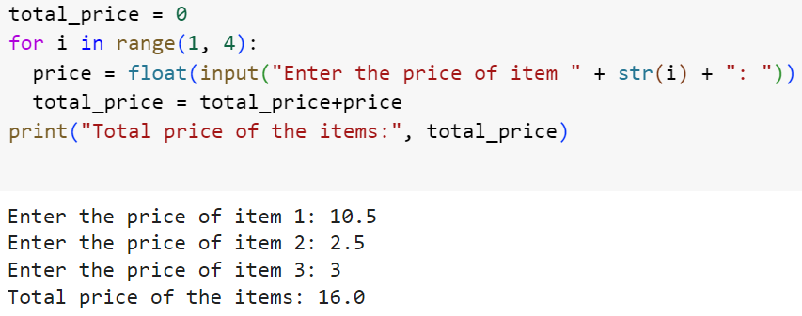
Using for loops in problem-solving
Write a Python program that calculates the total price of three items in a shopping cart.
The program should prompt the user to input the price of each item, sum these prices, and then print the total price.

Slide 25
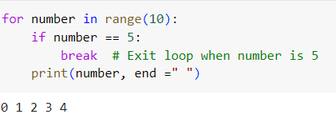
Using Break in loops
The break statement is used to exit a loop prematurely (before it is supposed to end).
It immediately stops the iterations and exits the loop.
What would print if we remove the break statement from the code?
Notes:
Answer: 0 1 2 3 4 5 6 7 8 9

Slide 26

Collaborative Task: Extend your knowledge
Work with your peer to develop the following Python code:
  Print the even numbers from 4 to 20, skipping the number 8.
Notes:
Elaborate

Slide 27

Peer review activity
Exchange your capitals dictionary program with another pair of students
Evaluate your peer’s code based on the following criteria:
  Does the code correctly print even numbers from 4 to 20, excluding 8?
  Is the logic implemented efficiently, avoiding unnecessary iterations?
  Are variable names meaningful and the code easy to read?
  Is the solution clear and free of errors?
Share strengths of the code and suggest improvements where needed.
Reflection Questions:
  What new insights did you gain from reviewing someone else's code?

Slide 28
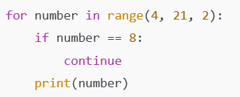
Sample Code Solution

Slide 29

Self-Assessment Checklist
Review your mastery of repetition statements using the following checklist:
  ✅ Can you explain the purpose of iteration and how loops automate repetitive tasks?
  ✅ Can you differentiate between for loops and while loops and choose the appropriate one for a given task?
  ✅ Can you use for loops to iterate over sequences effectively?
  ✅ Can you utilize the range() function with start, stop, and step parameters to control iteration?
  ✅ Can you implement the break statement to exit loops prematurely when necessary?
Notes:
Students Notes:
Scoring Rubric:
0-2 points: Review the key concepts and examples provided in the lecture.
3-4 points: Good understanding, but practice more coding exercises.
5 points: Excellent! You're ready to confidently use dictionaries in solving real-world programming problems.

Slide 30
Summary
An iteration, also known as a loop, allows you to write a sequence of operations once and run it multiple times.
Different types of loops (for and while) suit different programming needs.
for loops iterate over sequences, automating repetitive tasks.
The range() function generates numbers, with optional start, stop, and step parameters.
The break statement is used to exit a loop prematurely.

Slide 31
KEY TERMS
Iterations
for Loop
while Loop
range()
break
Notes:
Instructor Notes:
Student Notes:

Slide 32
Learning activities
Refer to Kahoot Quiz and Lab 6

